Slide 2
Java virtual machine (JVM)
A Java virtual machine (JVM) is an abstract computing machine that enables a computer to run a Java program.
There are three notions of the JVM: specification, implementation, and instance.
The specification is a document that formally describes what is required of a JVM implementation.

Slide 3
Byte Code
Java’s compiler translates code into Java byte code, which is run using a Java Virtual Machine (JVM).
JVMs must be installed or come with your operating system.
A JVM is an interpreter. The main advantage of an interpreter is that any computer can run it, making Java portable. Interpreters are slower, but using just-in-time compilation, they are getting faster.

Slide 4
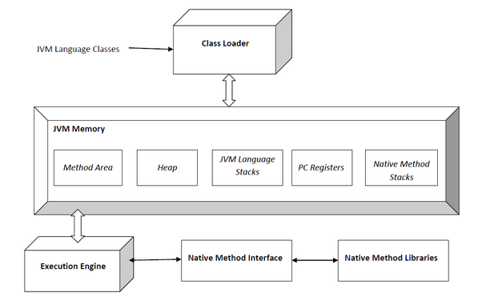

Slide 5
Java is a modern object-oriented programming language that uses the best features of classic languages
“pros” of using Java – in particular, that it is secure, robust, and portable. These features make Java ideal for network-based applications.
Java uses advanced programming concepts, such as threads.

Slide 6
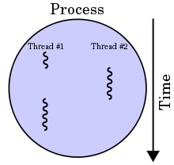
Thread
In computer science, a thread of execution is the smallest sequence of programmed instructions that can be managed independently by a scheduler, which is typically a part of the operating system

Slide 7
Applet
An applet is a small Internet-based program written in Java, a programming language for the Web, which can be downloaded by any computer. The applet is also able to run in HTML. The applet is usually embedded in an HTML page on a Web site and can be executed from within a browser.

Slide 8
Java runs more slowly because it is interpreted.
Java is a compiled programming language, but rather than compile straight to executable machine code, it compiles to an intermediate binary form called JVM byte code. The byte code is then compiled and/or interpreted to run the program

Slide 9
A ______ is a process that can run concurrently with other processes.
Java bears a resemblance to which programming language?

Slide 10
A ______ is a process that can run concurrently with other processes.
Answer: thread
Java bears a resemblance to which programming language?
Answer: C++

Slide 11
True or False? Java compilers translate code into machine language.
.
True or False? Programs that run with interpreters typically run more slowly than those that have been compiled to machine code.
What kind of Java program runs in a Web browser?
A. application B. applet

Slide 12
True or False? Java compilers translate code into machine language.
Answer: False. Java code is translated into Java byte code.
True or False? Programs that run with interpreters typically run more slowly than those that have been compiled to machine code.
Answer: True.
What kind of Java program runs in a Web browser?
A. application
B. applet
Answer: B

Slide 13
Homework :
Page 32 Exercise 2.1
Page 34 Exercise 2.2
Page 36 Exercise 2.4
Assignment1 exercise in class.
Assignemt2 is on EdModo
Due Friday

